Slide 1
Decision Making

Slide 2
Decision Making
Decision making occurs as a reaction to a perceived problem
Making sound decisions is a skill set that needs to be developed like any other
Nothing will test your leadership mettle more than your ability to make decisions.
Gut instincts can only take you so far in life.
Operating outside of a sound decision making framework will eventually fall prey to an act of oversight, misinformation, misunderstanding, manipulation, impulsivity or some other negative influencing factor.

Slide 3
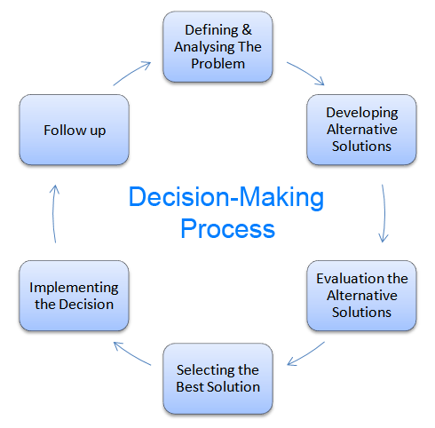
Rational Decision Making Process

Slide 4
Assumptions of the Model
Complete knowledge of the situation
All relevant options are known in an unbiased manner
The decision-maker seeks the highest utility
No time constrain

Slide 5
Bounded Rationality
People seek solutions that are satisfactory and sufficient, rather than optimal (they “satisfice”)
Bounded rationality is constructing simplified models that extract the essential features from problems without capturing all their complexity

Slide 6
Decision Making in Bounded Rationality
Simpler than rational decision making, composed of three steps:
Limited search for criteria and alternatives – familiar criteria and easily found alternatives
Limited review of alternatives – focus alternatives, similar to those already in effect
Satisficing – selecting the first alternative that is “good enough”

Slide 7
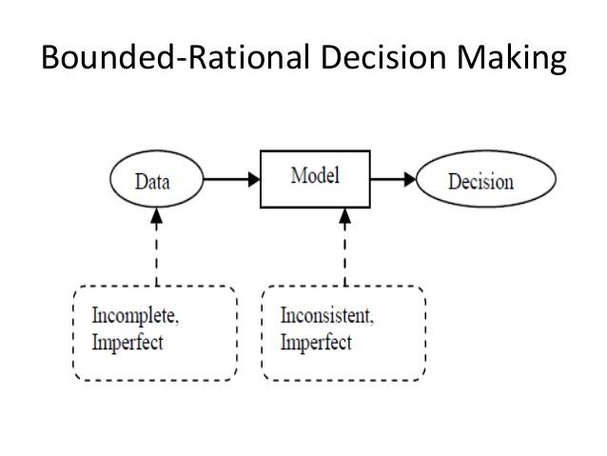

Slide 8
Intuitive Decision Making
An non-conscious process created out of distilled experience
Increases with experience
Can be a powerful complement to rational analysis in decision making

Slide 9
Common Biases and Errors
Overconfidence Bias
Believing too much in our own ability to make good decisions – especially when outside of own expertise
Anchoring Bias
Using early, first received information as the basis for making subsequent judgments
Confirmation Bias
Selecting and using only facts that support our decision

Slide 10
Availability Bias
Emphasizing information that is most readily at hand
Recent
Vivid
Escalation of Commitment
Increasing commitment to a decision in spite of evidence that it is wrong – especially if responsible for the decision!
Randomness Error
Creating meaning out of random events – superstitions
Winner’s Curse
Highest bidder pays too much due to value overestimation
Likelihood increases with the number of people in auction

